Slide 1
Geologic Timescale

Slide 2
Notes on Geologic Time
Transform the article given to you into Cornell Notes

Slide 3
Warm-up
Eons are broken down into ______ which are broken down into _______ which are broken down into ______ are further broken down into _____.

Slide 4
Warm-Up
How are new ages or epochs determined? In other words, how does a new epoch begin?
Are we living in a new epoch? Have humans altered the planet enough to start a new age?
Let’s watch this video to add to our knowledge.

Slide 5
Earth’s Past
Mapped in Rocks
Look for extinction lines or drastic changes in life forms

Slide 6
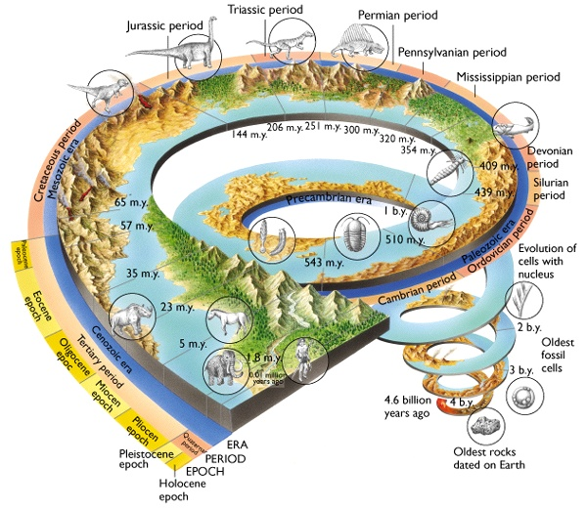
Geological Time Units
Eons
Eras
Periods
Epochs
Ages

Slide 7
Beginning of Earth’s History
Nebula
Planetary accretion (Planetestimal becomes a Molten Protoplanets)
Meteorites aged to 4.6 billion years old
Moon is formed (4.5 bya)
Planetary Cooling creates Core, Mantle, Crust
Oldest rock is 4.4 billion years old

Slide 8
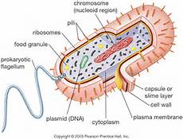
Beginning of Life on Earth
Prokaryotes

Slide 9
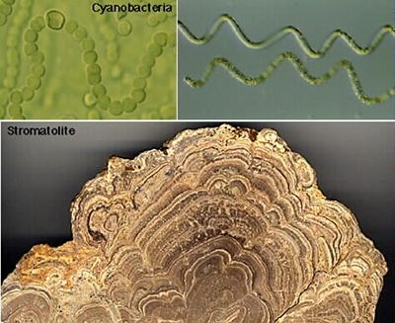
Beginning of Life on Earth
Cyanobacteria
Stromolites…fossilized microbial mats (3.5 bya)
Create food via photosynthesis
Responsible for rise of oxygen in atmosphere

Slide 10
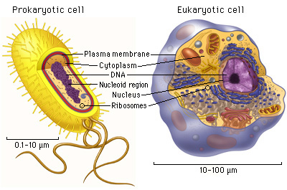
Beginning of Complex Life on Earth
Eukaryotes
Development of a nucleus and membrane organelles allowed for more complex, multicellular organisms to evolve

Slide 11
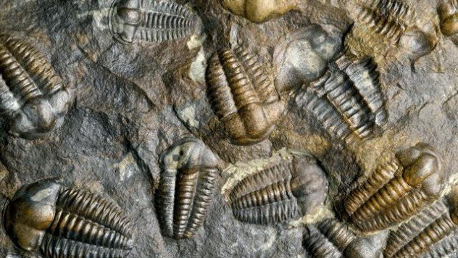
Cambrian Explosion
An Explosion of Life!!!

Slide 12
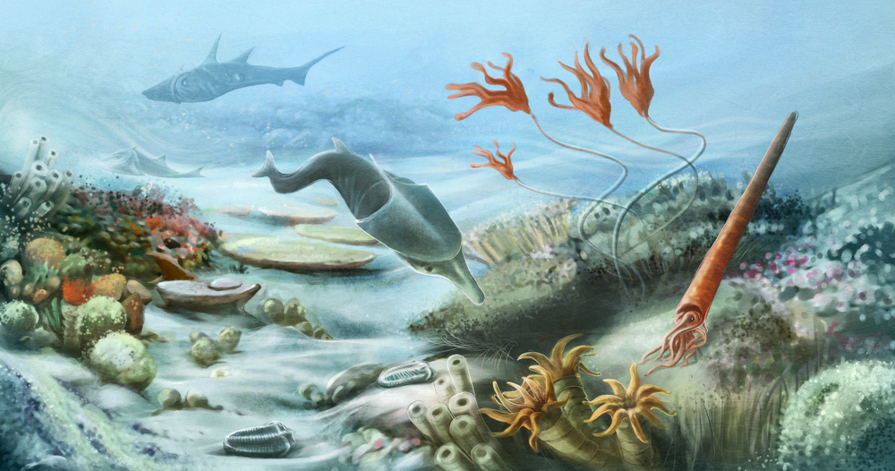
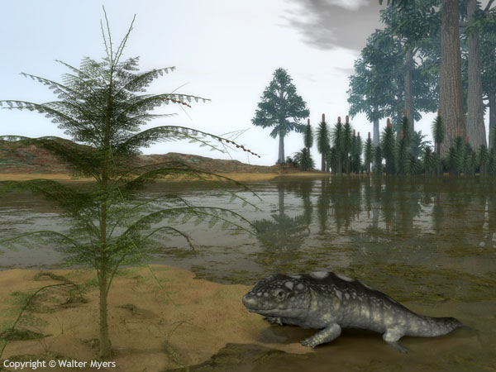
Paleozoic Era
First era of diverse life
Mostly marine invertebrates
Coral, sponges, crabs
Some vertebrates…fish
First terrestrial organisms
Arthropods, amphibians and some primitive reptiles

Slide 13
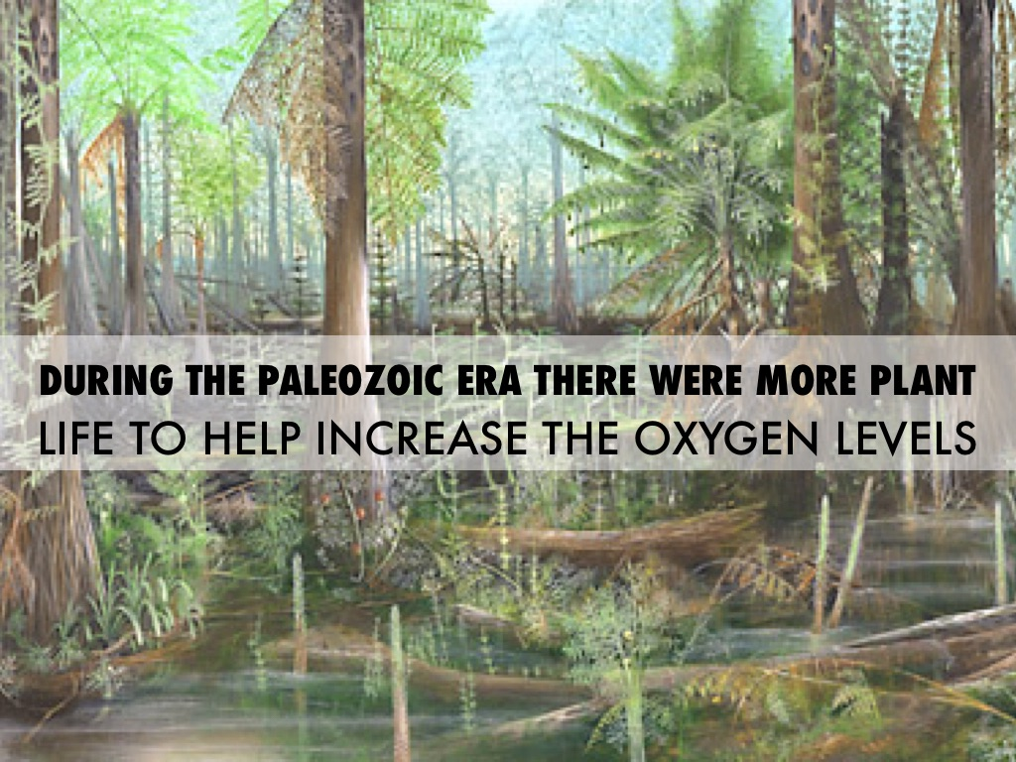
Appearance of plants
Microbes allowed land plants to evolve by altering nitrogen in the atmosphere to a usable form (like fertilizer)
Plants then went on to change the Earth by…
Altering the atmosphere….oxygen, rainfall
Altering the geosphere…increased moisture in soil, increased nutrients in soil which allowed for more life to exist

Slide 14
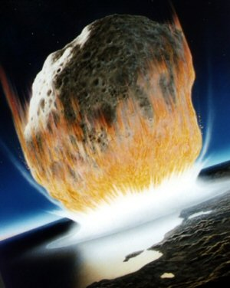
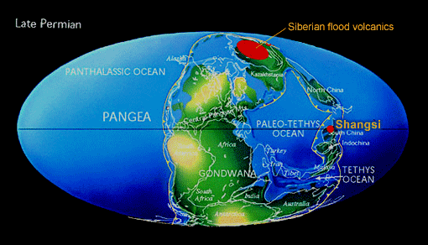
Permian-Triassic Extinction
Cause unknown
Asteroid impact or extreme volcanic events
Largest Mass Extinction
80-96% of Marine Life
70% Land Vertebrates

Slide 15
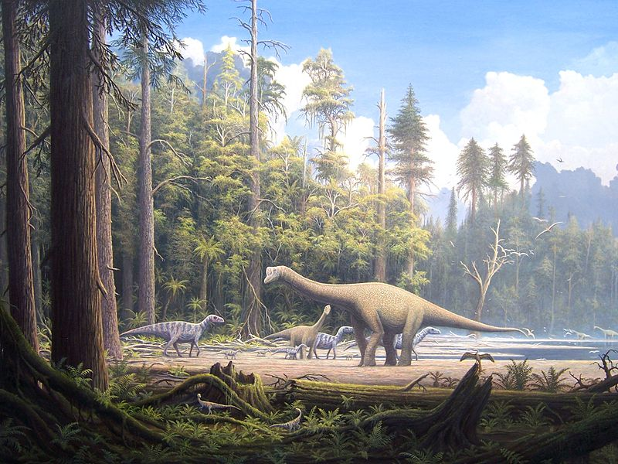
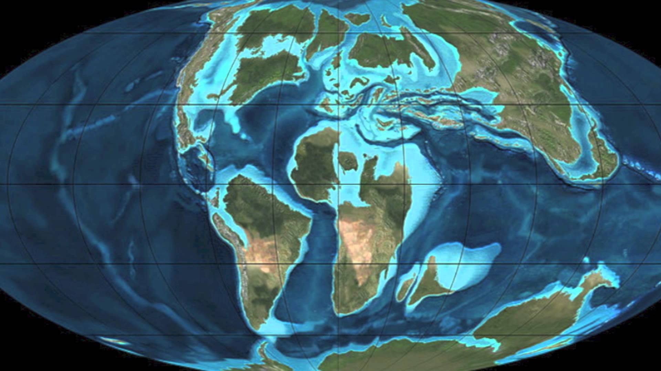
Mesozoic Era
The Age of Reptiles!!!! Dinosaurs!!!!!
Land covered with gymnosperms (ancestors to evergreen trees)
Reptiles replaced amphibians as the dominant land vertebrates.
Reptiles evolved to life on Earth by developing large lungs, eggs with waterproof shells and scaly, waterproof skin
Ended with another extinction event

Slide 16
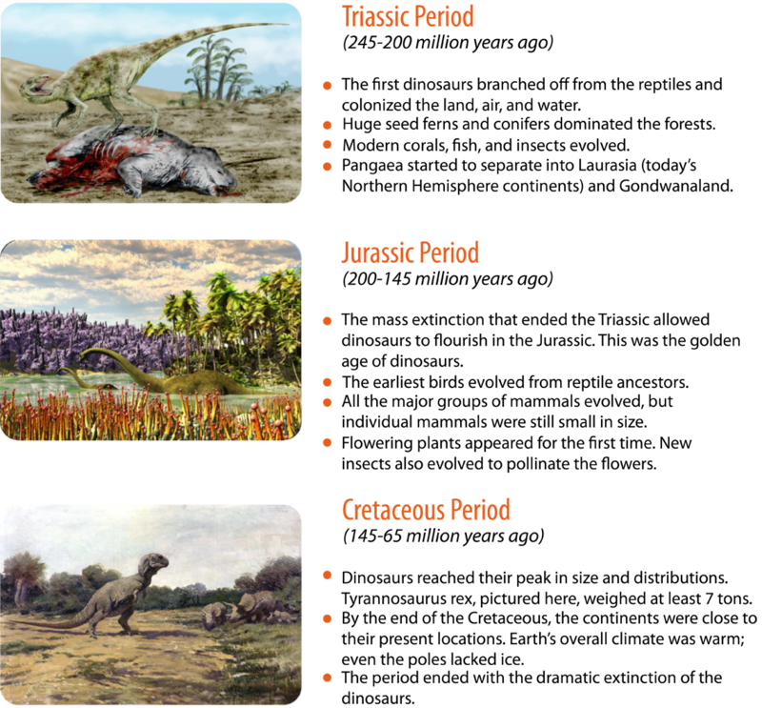

Slide 17
Cenozoic Era
Age of Mammals!!!
Mammals coexisted with dinosaurs but did not flourish until this era.
Humans appeared 200,000 years ago (Babies in Geologic Time)
Human history goes back only 10,000 years

Slide 18
Activity
We are going to create a scaled timeline to help us picture the history of Earth.

Slide 19
A New Epoch???
Are Humans Changing our Planet enough to start a new Epoch??
Are we living in the sixth mass extinction???
Let’s read about it…
Sign into Newsela.
Complete the assigned article titled Scientists say Earth's timeline is ready for a new entry

